Slide 1
Healthy Weight on FHIR CDC Analytics Reporting Application
Team-Too Deiverable 1: Topic Presentation

Slide 2
Healthy Weight / Obesity Challenges
Obesity is a significant public health concern
Tracking and changing behaviors is difficult
Data collection and analysis difficulties
Obesity on the Rise
Serious health risks
Diminished quality of life
Expensive long-term medical care
Chronic disease
Poor monitoring
Need easy-to-use tools to assess individual risk
Evaluate personal characteristics & behaviors
Personalized feedback on targets & performance
Increase utilization
Provide improved interoperability
Useful to patients, physicians, and health organizations
Leverage HL7 & SMART FHIR capabilities

Slide 3

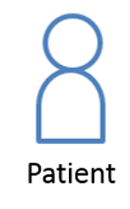
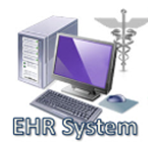
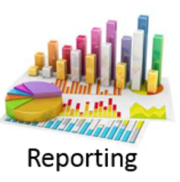
Project Goal: Develop application to better understand and prevent childhood obesity
Care Manager
Used by care manager to manage physician referrals
Patient
Provider
Used by patients to track behaviors relevant to obesity
Used by physicians to track and interpret patient data
Analytics & Reporting
Aggregates collected data and analyzes at a population level

Slide 4
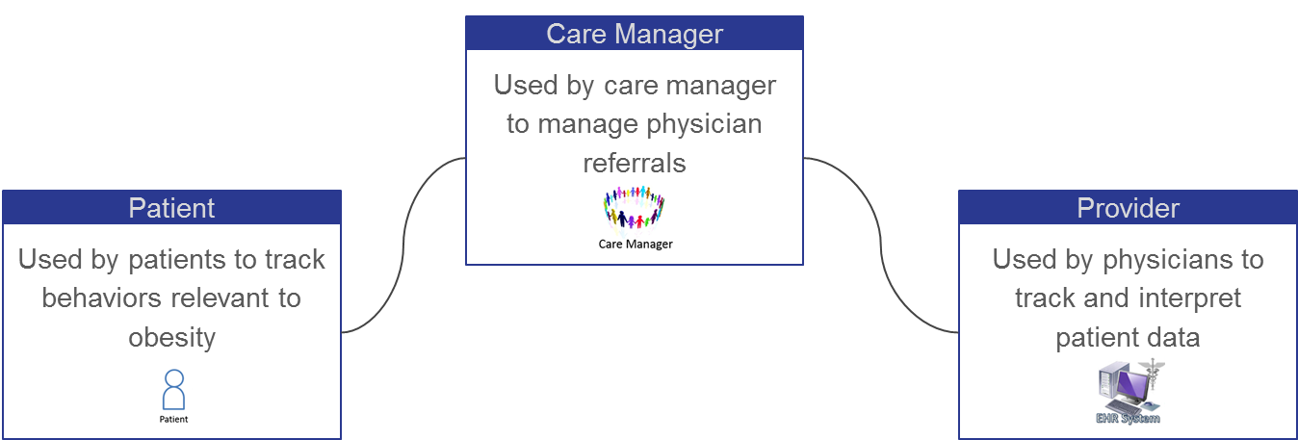
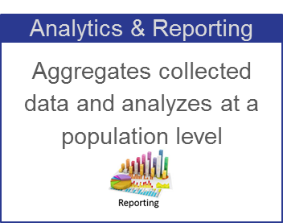

Team Focus: Data utilization and operability

Slide 5
Proposed Solution:
Improved functionality for obesity risk screening
Manage data for behavioral targets of obesity including eating and exercise habits
Determination and tracking of Body Mass Index (BMI)
Population-level analysis & distributions
Progress tracking of healthy weight targets
Leverage open source components & maintain open development
Develop framework for aggregating data, performing analytics and providing flexible reporting & visualizations

Slide 6
Implementation Features:
Data accessible to patient-facing, physician-facing and care manager applications
Leverages FHIR server
Flexible data aggregation by fields
Graphical User Interface (GUI) allows for selection of key features
Visualizations for weight-associated data
Secured data access (identified & de-identified)
Integration into electronic health records and operable according to health industry standards (HL7/IHE)
Analytics & Reporting
Application

Slide 7
Useability:
Web implementation assessible to other apps
Secured single log-in
Data sharing & analytics integration
GUI for generating analysis & reports
Data selection & grouping
Intuitive database queries
Visualization tools
User-configurable graphing features
Retrieve records in manageable format
Exporting functions
Common format output for export to other systems (.xml, .csv)
Creation of .pdf reports
Analytics & Reporting
Application

Slide 8
Team-Too
Project Manager
Developer
Daniel Hegberg
Data analysis & reporting
Frontend Developer
Backend Developer
David Bailey
David Stevens
User Interface Design
Report generation
Quality Assurance
Team Liaison
Analytics
Developer
Kirk Pastorian
Brandon Duck
Research & Testing
Analytical methodology

Slide 9
Tools:
C#
Highcharts
Javascript charts for GUI
Non-commercial licenses available
AngularJS
Framework for client-side model-view & controller architecture
Frontend
Fast Healthcare Interoperability Resources (FHIR) server
Serves a primary database resource for the application
SQL Server
Backend

Slide 10
Tools:
Data
Publicly available datasets -- to be determined
Georgia Tech FHIR Server
Current version feature-limited
-- Consider move to another server
-- Consider update to Georgia Tech server
Data Transfer APIs
Data export -- for connection to other systems
Data encryption
External
Resources

Slide 11
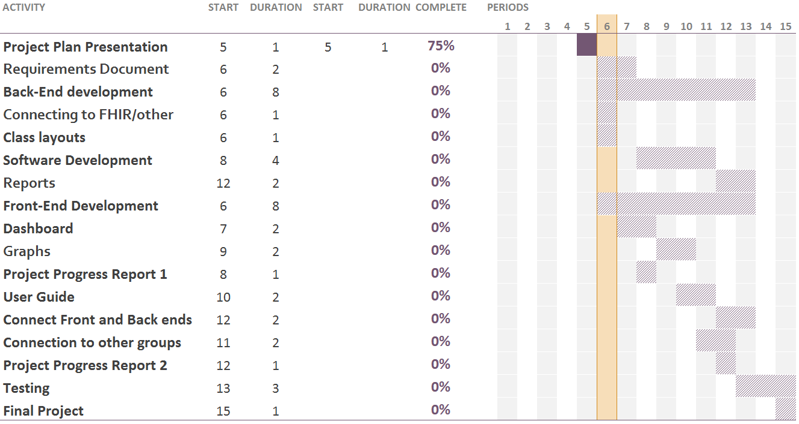
Development -- Gantt Chart
Project Plan
& Requirements
Connect to
FHIR Database
Analyze
Public Datasets
Dashboard
& Export tool
Testing
& Release

Slide 12
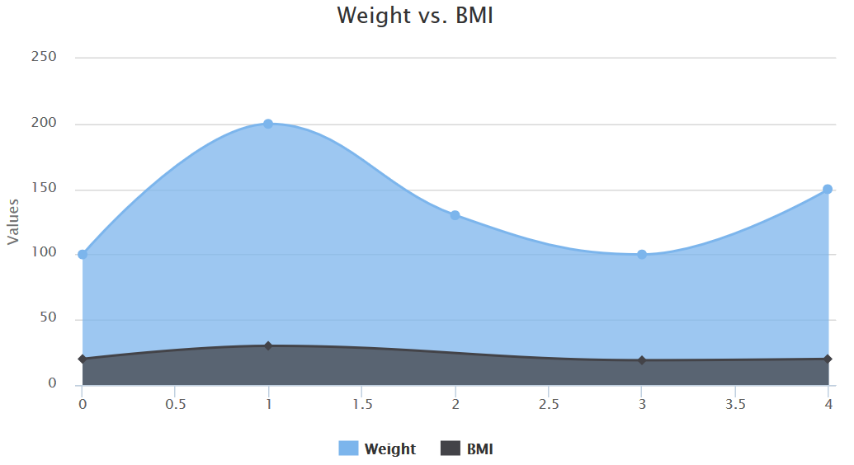
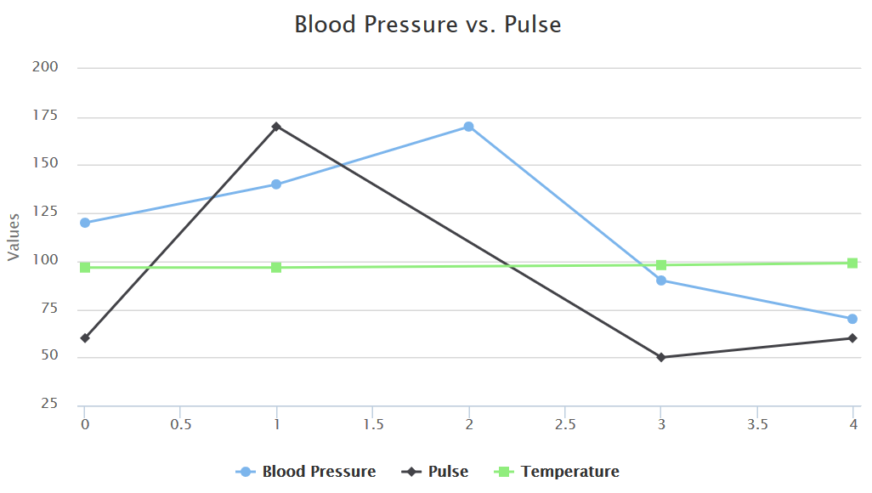
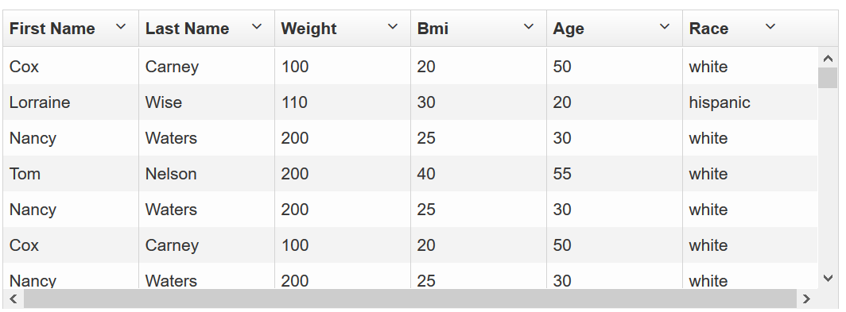
Results!

